Slide 1

算法分析与设计
Analysis and Design of Algorithms
山东大学 · 软件学院
2017年

Slide 2
26. Maximum Flow Problem
Definitions and notations
The Ford-Fulkerson method
Maximum bipartite matching

Slide 3
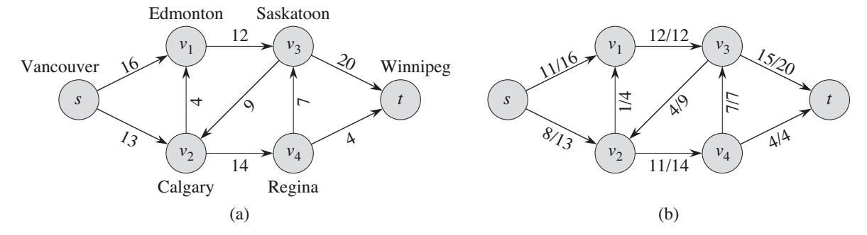

Flow Networks
A flow network G=(V,E) is a directed graph, where each edge (u,v)∈E has a nonnegative capacity c(u,v)$≥$ 0.
If (u,v)∉E, we assume that c(u,v)=0.
two distinct vertices : source s and sink t.

Slide 4

Flow
Given a flow network G=(V,E) with capacity function c. Let s be the source and t the sink.
A flow in G is a real-valued function $f:V×V→R$ satisfying the following two properties:
Capacity constraint: For all u, v ∈V, 0 ≤ f(u, v) ≤ c(u, v).
Flow conservation: For all u ∈V-{s, t},

Slide 5
Value of a Flow
The value of a flow is defined as

Slide 6
Maximum-flow Problem
Input: a flow network G
Output: a flow of maximum value

Slide 7
The Ford-Fulkerson Method
Why “method” not “algorithm”?
The Ford-Fulkerson method depends on three important ideas:
Residual Network, Augmenting Path, and Cut.
These ideas are essential to the important max-flow min-cut theorem, which characterizes the value of maximum flow in terms of cuts of the flow network.

Slide 8
The Ford-Fulkerson Method
FORD-FULKERSON-METHOD(G,s,t)
initialize flow f to 0
while there exists an augmenting path p
do augment flow f along p
return f

Slide 9
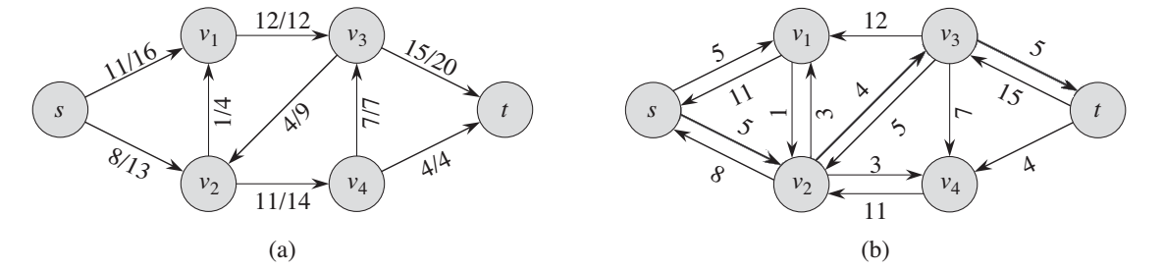
Residual Networks
Given G=(V, E) : a flow network with source s and sink t;
f : a flow in G.
Residual network: G_{f} = (V, E_{f} ), where E_{f} ={(u,v) ∈V×V: c_{f} (u,v) > 0}
forward edge: c_{f} (u,v) = c(u,v) - f (u,v)
backward edge: c_{f} (u,v) = f (v,u)

Slide 10
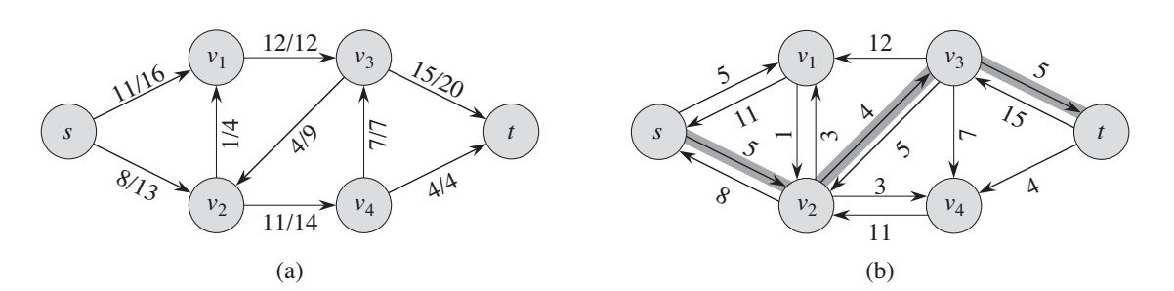
Augmenting paths
Given a flow network G=(V, E) and a flow f, an augmenting path is a simple path from s to t in the residual network G_{f}.
Residual capacity of p : the maximum amount of flow that we can ship along the edges of an augmenting path p, i.e.,
c_{f} (p) = min { c_{f} (u,v): (u,v) is on p}.

Slide 11
Augmenting Path

Slide 12
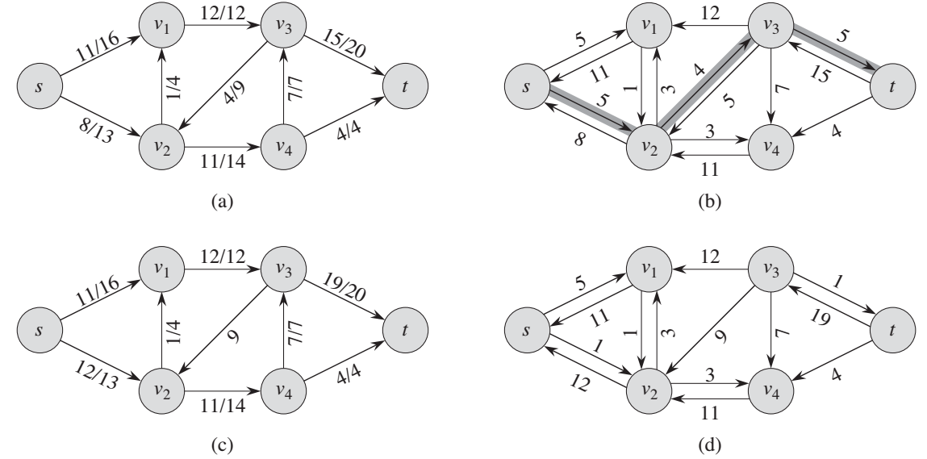
Augmenting Path

Slide 13
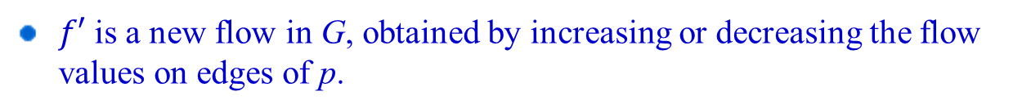
Augmenting Path
v1
20/20
0/10
S
20/30
t
0/10
20/20
v2
v1
v1
v1
20
10
20
10
20/20
10/10
S
10
20
t
S
10
20
t
S
10/30
t
10
20
10
20
10/10
20/20
v2
v2
v2
$f′$ is a new flow in G, obtained by increasing or decreasing the flow values on edges of p.

Slide 14
Augmenting Path
$f′$ is a flow in G. Why?
|$f^{′}|=\left|f\right|+cf(p)$. Why?
这两个结论的证明参考《Algorithm Design》by Jon Kleinberg, Eva Tardos一书的p342-345，更直观！

Slide 15
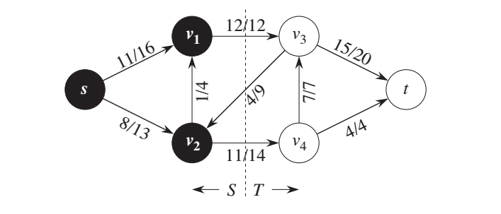
Cut
Cut (S, T): S is a subset of V, T =V-S, s∈S and t∈T.
Net flow across the cut (S,T): f(S,T)
Capacity of the cut (S,T): c(S,T)
Minimum cut of a network: a cut whose capacity is minimum over all suts of the network.

Slide 16
Cut
这两个结论的证明参考《Algorithm Design》by Jon Kleinberg, Eva Tardos一书的p346-348，更直观！

Slide 17
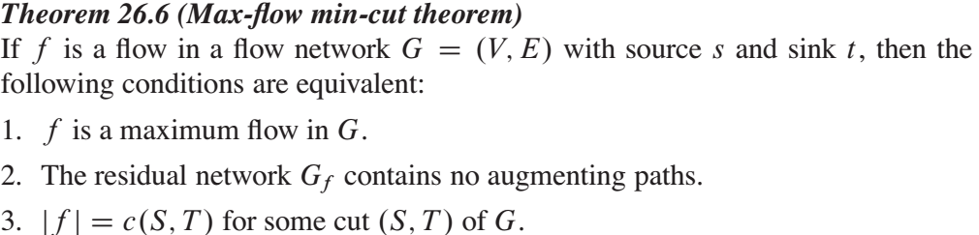
Cut

Slide 18
The Ford-Fulkerson Method
FORD-FULKERSON-METHOD(G,s,t)
initialize flow f to 0
while there exists an augmenting path p
do augment flow f along p
return f

Slide 19
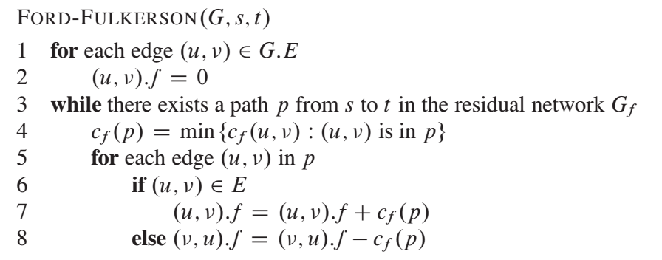
The Basic Ford-Fulkerson Algorithm

